Slide 1
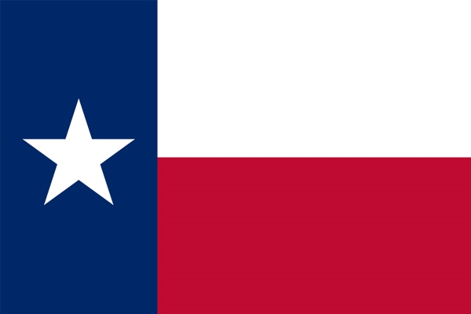
TEXAS LIQUOR ANALYSIS
TEXAS
MIXED
BEVERAGE
ANALYSIS
GROUP 1
GROUP 1
BETZY
JORGE
KELLI
SAATVI
BETZY, JORGE, KELLI & SAATVI

Slide 2
AGENDA
Inspiration
Hypothesis
Analysis
Key Takeaways
Limitations & Future analysis
Q&A

Slide 3
INSPIRATION
Use skills learned during bootcamp to prove antidotal claims we’ve heard about the liquor industry. We no longer just must trust what we hear; we can investigate ourselves!
Who else might be interested in this dataset? - Investors
The data is from the years 2019 and 2020 and in the top 5 markets in the state: Dallas, Ft. Worth, Houston, Austin & San Antonio.

Slide 4
HYPOTHESIS
Unemployment and liquor beverage sales have a positive correlation, exception might be covid due to forced closures.
We expected to see mixed beverage sales increase around holidays, such as New Years, Easter, Independence Day, Thanksgiving and Christmas.

Slide 5
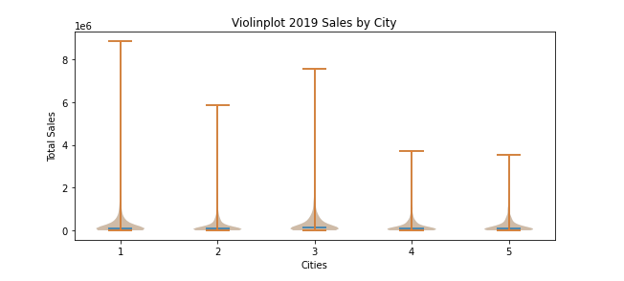
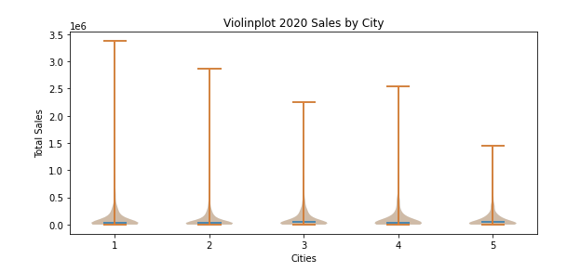
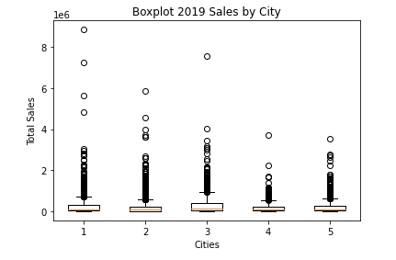
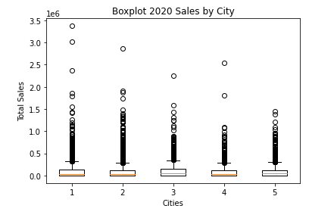
VIOLINPLOT & BOXPLOTS 2019 SALES BY CITIES

Slide 6
VIOLINPLOT & BOXPLOTS 2020 SALES BY CITIES

Slide 7
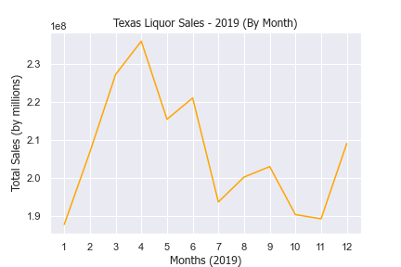
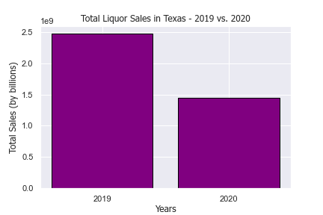
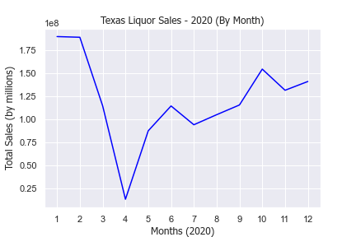
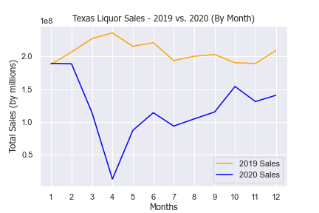
LIQUOR SALES 2019 VS 2020

Slide 8
LIQUOR SALES BY MONTH

Slide 9
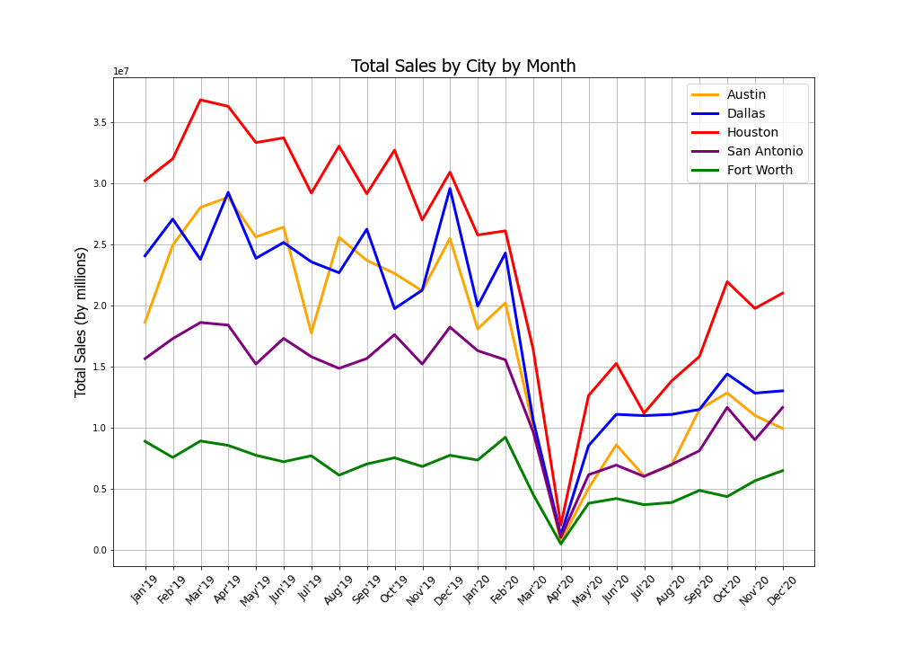
TOTAL SALES CITY BY MONTH

Slide 10
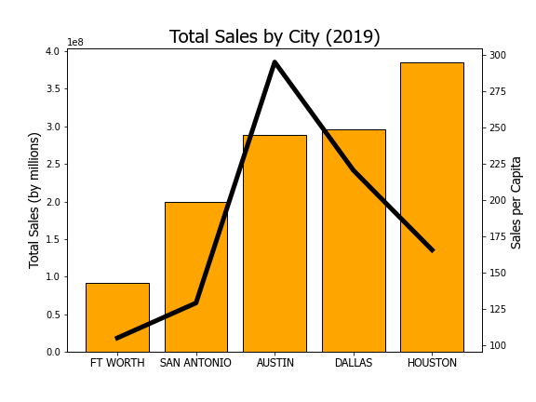
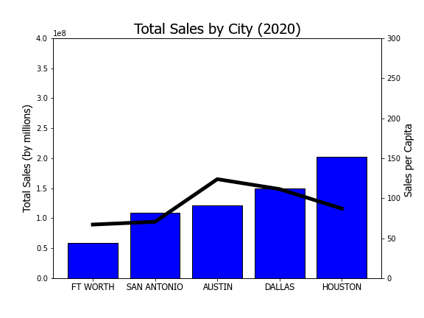
TOTAL SALES BY CITY
Austin Ranked 3rd in Total Sales but 1st in Sales per Capita

Slide 11
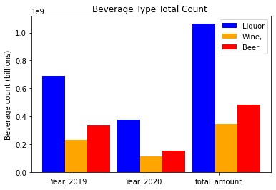
BEVERAGE PREFERENCES

Slide 12
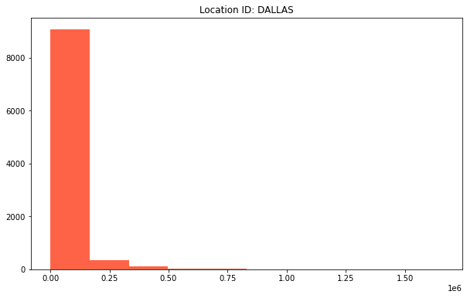
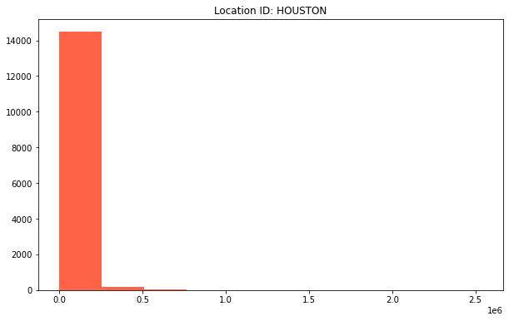
T-TEST

Slide 13
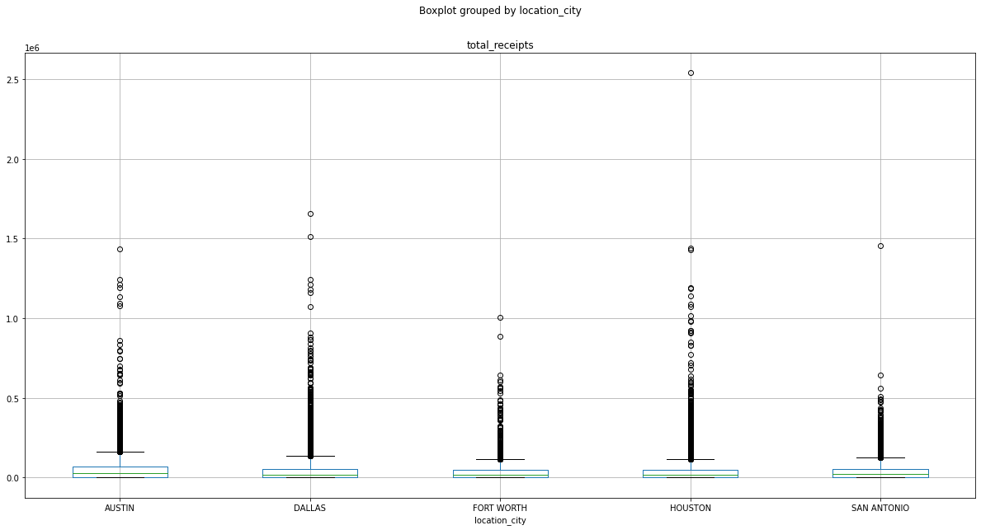
ANOVA TEST
F onewayResult(statistic=51.08573623104522, pvalue=5.517933878848488e-43)

Slide 14
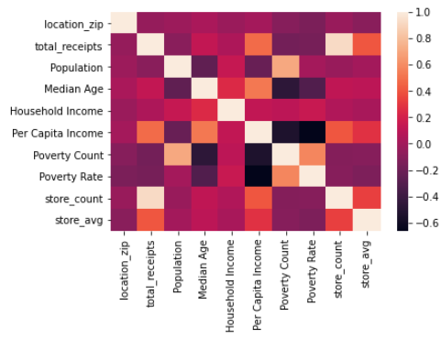
REGRESSION CHARTS

Slide 15
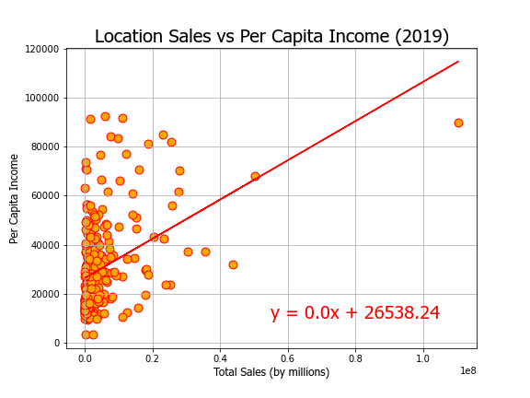
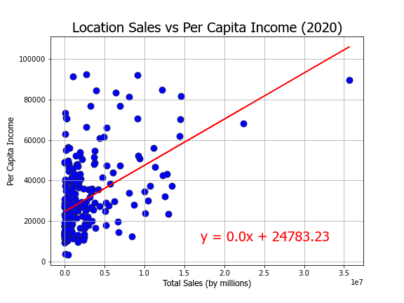
REGRESSION CHARTS
The r-squared is: 0.17128906610663705
The r-squared is: 0.23548527744499823

Slide 16
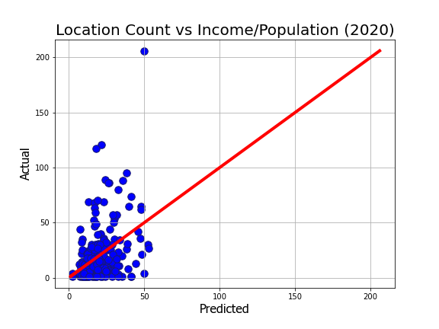
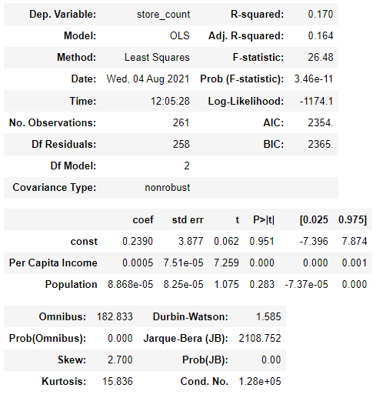
MULTIPLE REGRESSION CHARTS

Slide 17
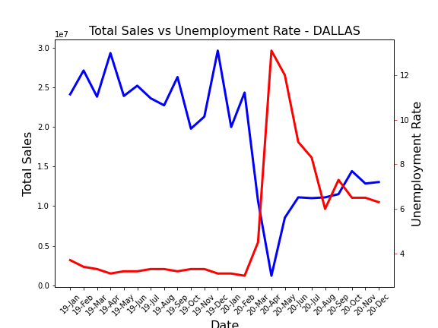
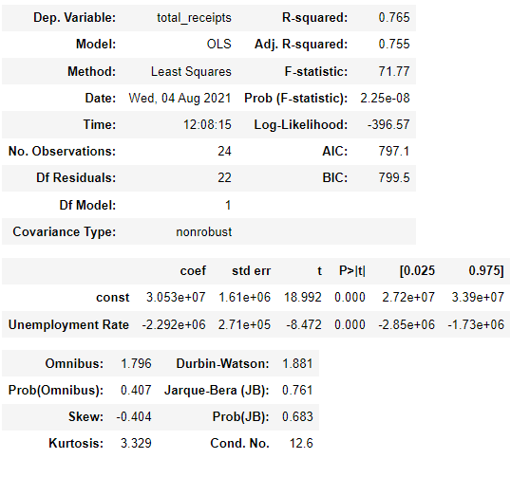
REGRESSION CHARTS

Slide 18
FINAL CONCLUSION
Unemployment and mixed beverage sales have a positive correlation, exception might be ”covid” due to forced closures.
False – Unemployment had a negative impact on sales
We expect to see mixed beverage sales increase around holidays, such as New Years, Easter, Independence Day, Thanksgiving and Christmas.
False – monthly sales were very volatile by cities, no strong seasonal tend identified.

Slide 19
LIMITATIONS & FUTURE ANALYSIS
Analyze full data set
longer time frame as 2020 was not a normal year.
full details for all cities in Texas.
Segment out location types
Venues, hotels, restaurants, liquor stores, etc.
More time to analyze outliers and remove from dataset
Inner city vs outer city analysis
Research if additional data sets are available.

Slide 20
Q&A

Slide 21
TOTAL SALES CITY BY MONTH

Slide 22
TOTAL SALES BY CITY
Austin Ranked 3rd in Total Sales but 1st in Sales per Capita

Slide 23
BEVERAGE PREFERENCES

